Slide 1
Pretraining models

Slide 2
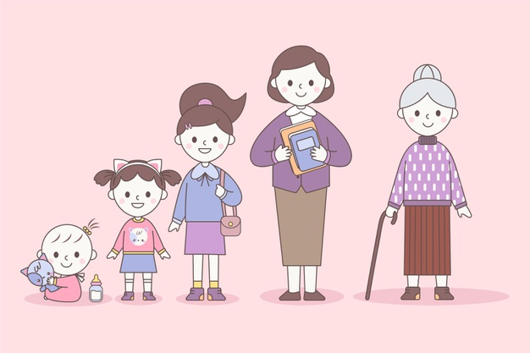
Teaching a model how to categorize text is like asking a toddler how to categorize text
I don’t understand what you are saying, but I will try to give a label based in previous information I have.

Slide 3
Teaching a model how to categorize text is like asking a toddler how to categorize text
Learns to talk

Slide 4
Teaching a model how to categorize text is like asking a toddler how to categorize text
I understand general language. I will be able to classify into general topics like sport, tech, politics ...
Learns to talk

Slide 5
Teaching a model how to categorize text is like asking a toddler how to categorize text
Learns to talk
Goes to university and learns jargon

Slide 6
Teaching a model how to categorize text is like asking a toddler how to categorize text
I became a lawyer and can now classify legal documents in different categories.
Learns to talk
Goes to university and learns jargon

